Slide 1

DELE CA2 PART b
By:
Lim Jun Yi
Randal Hong

Slide 2
Task
Apply a suitable modification of deep Q-network (DQN) to the problem.
The model should exert some appropriate torque on the pendulum to try and balance it.

Slide 3
Exploratory data analysis

Slide 4
Background information
The inverted pendulum swing up problem is based on the classic problem in control theory.
The system consists of a pendulum attached at one end to a fixed point, and the other end being free.
The pendulum starts in a random position and the goal is to apply torque on the free end to swing it into an upright position, with its center of gravity right above the fixed point.

Slide 5
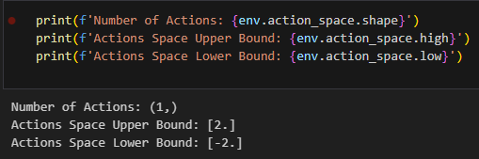
Actions
The agent can apply a torque of [-2.0, 2.0] to the pendulum. Torque is measured in Nm.
The direction of a positive torque acts in the counter-clockwise direction while the direction of a negative torque acts in the clockwise direction.
This is a set of continuous action space (infinite possible values of torque within fixed range that can be applied on the pendulum).

Slide 6

Observations
There are 3 continuous observations in the environment (infinite possible values of the pendulum's free-end position and angular velocity):
x: The x-coordinate of the pendulum's free-end, measured in m. Derived by x = cos($θ$) with a range of [-1.0, 1.0].
y: The y-coordinate of the pendulum's free-end, measured in m. Derived by y = sin($θ$) with a range of [-1.0, 1.0].
Angular Velocity: The angular velocity of the pendulum's free-end. The range is [-8.0, 8.0].

Slide 7

Rewards
After a torque is applied to the pendulum, the agent receives a reward for that action. The reward is calculated as follows:
$$r=−\left(θ^{2}+0.1∗θ_ⅆt^{2}+0.001∗{torquⅇ}^{2}\right)$$
where $θ$is the angle of the pendulum normalized between [-$π$, $π$] (with 0 being in the upright position), $θ$_dt is the angular velocity of the pendulum, and torque is the torque applied to the pendulum.

Slide 8

Rewards
The minimum reward that can be obtained is:
$$−\left(π^{2}+0⋅1∗82+0.001∗22\right)=−16.2736044$$
while the maximum reward is zero (pendulum is upright with zero velocity and no torque applied). Hence, r is between [-16.2736044, 0].
Note: Reward =/=Return. Return is the sum of rewards obtained from the start of the episode to an end of an episode.

Slide 9
Modelling

Slide 10
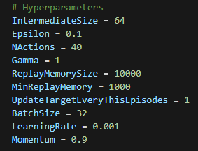
Modelling Overview
Baseline Model (with Untuned Hyperparameters)
Improved Model (with Tuned Hyperparameters)
The selected hyperparameters to be tuned to obtain the best results include:

Slide 11

Additional information
Starting State
The pendulum starts in a random angle in [- $π$, $π$] with a random angular velocity in [-1, 1].
Episode Truncation
- The episode is truncated after 200 steps.

Slide 12
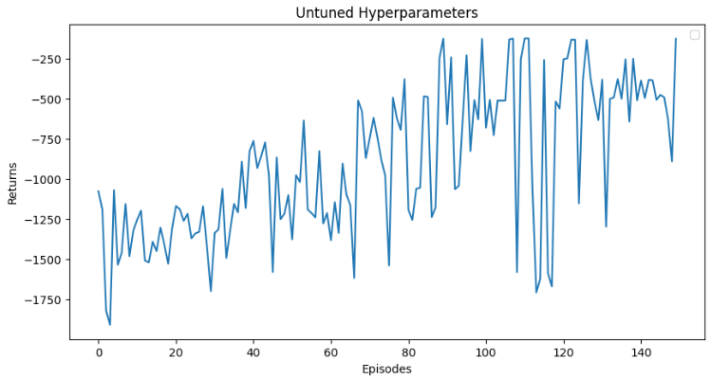
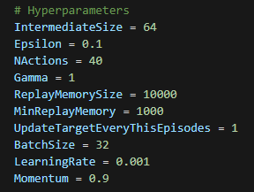
Baseline model
This model is found in the code given to us. This model serves as a baseline to be compared to the other models during the tuning of hyperparameters.

Slide 13
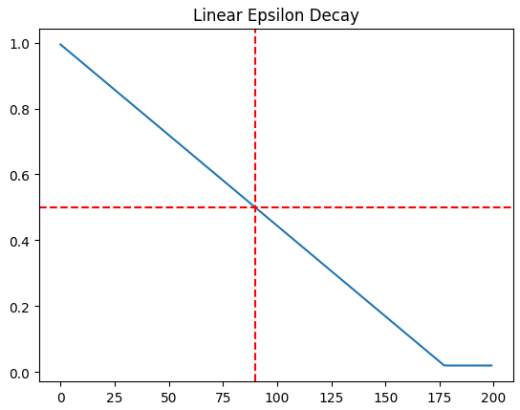
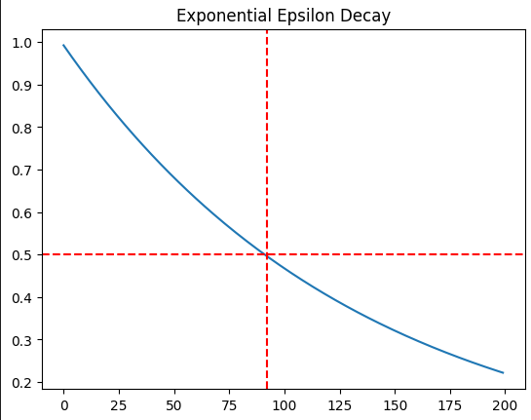
Epsilon & gamma
Our goal is to be far-sighted, but not too far-sighted that the agent becomes too greedy and fails to take into consideration the future impact of the current action.
We also want the model to explore more at the start to learn the environment better and discovering more actions rather than sticking to a single action that it perceives as good. However, as the episode progresses, we want the model to exploit more by taking actions that maximize the reward.
Hence, we will use epsilon decay to decrease the exploration rate as the episode progresses.
Linear Decay
Exponential Decay

Slide 14
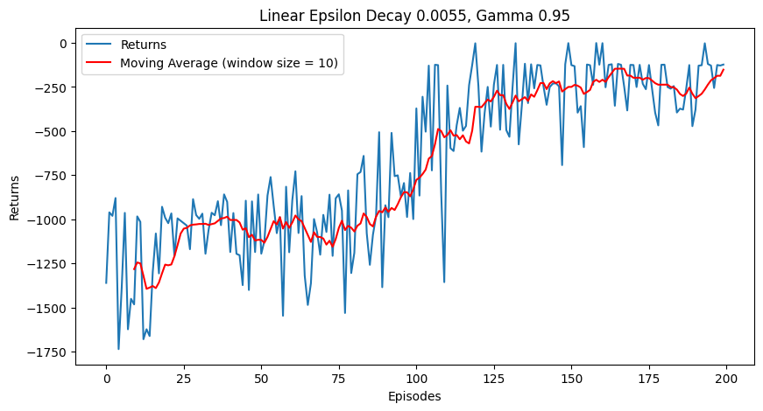
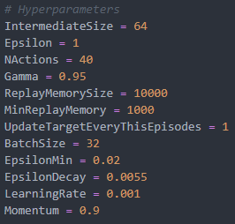
Hypertuned models
Linear Epsilon Decay
Gamma 0.95
General Uptrend
Fairly Stable

Slide 15
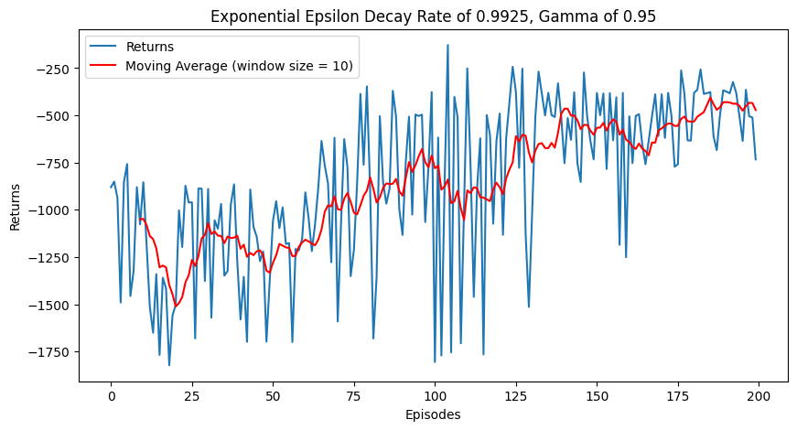
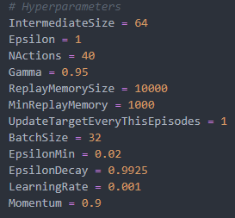
Hypertuned models
Exponential Epsilon Decay
Gamma 0.95
Very Unstable
General Upward Trend

Slide 16
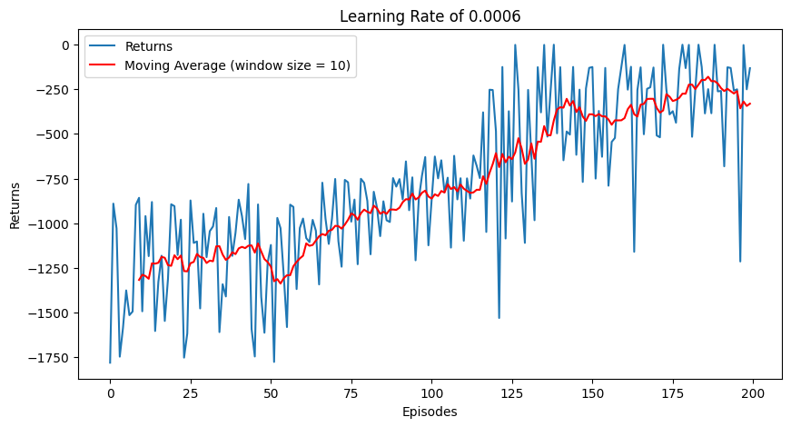
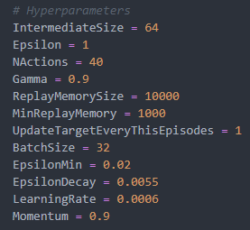
Hypertuned models
Smoother general uptrend
Moving average is smoother
Returns fluctuate a lot

Slide 17
Model Evaluation

Slide 18
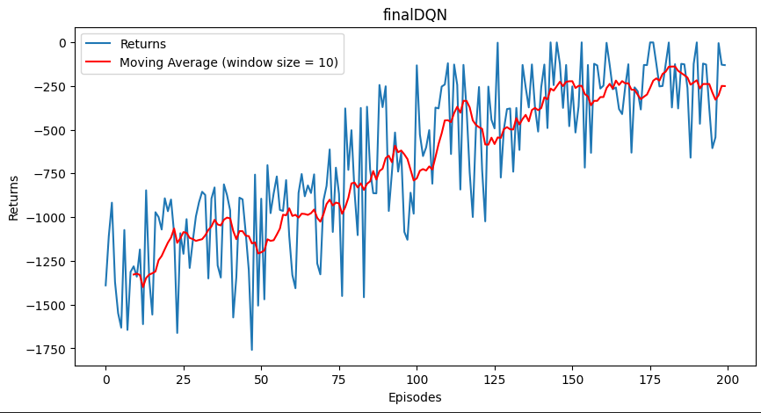
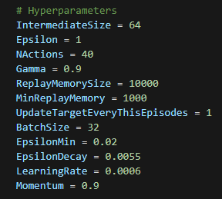
Final model
Gamma 0.95
Linear Epsilon Decay Rate 0.0055
Minimum Epsilon
Learning Rate 0.0006
NActions 40 (0.1 difference per action)

Slide 19
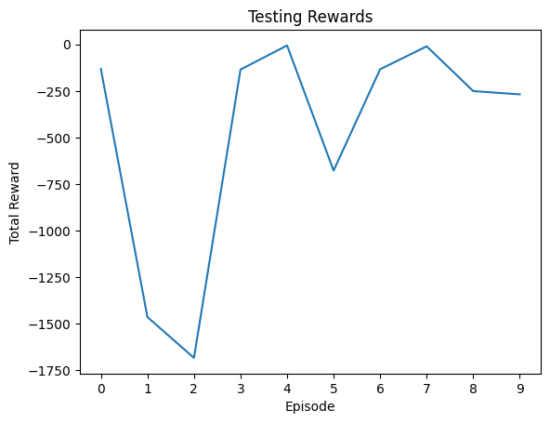
Test for 10 episodes
Unstable
Performs well 4/9 times or 44.44%
Can be improved using other algorithms such as PPO and DDPG

Slide 20
questions

Slide 21
Explain the differences between this code and the lab code for cartpole.
Cartpole
Discrete action space
Exponential epsilon decay
Higher memory replay size
Pendulum
Continuous action space
Linear epsilon decay
Lower memory replay size

